Slide 1

Seed Table Construction for Counting and Searching Substrings on GPU
ECE 277 WI22 Group Project
Krish Vadodaria(A59002291)
Monil Shah(A59012111)
Notes:
Hello everyone,
I am Krish Vadodaria. Monil and I have worked on seed table construction for counting and searching substrings on GPU and we will be discussing our work with you today.

Slide 2
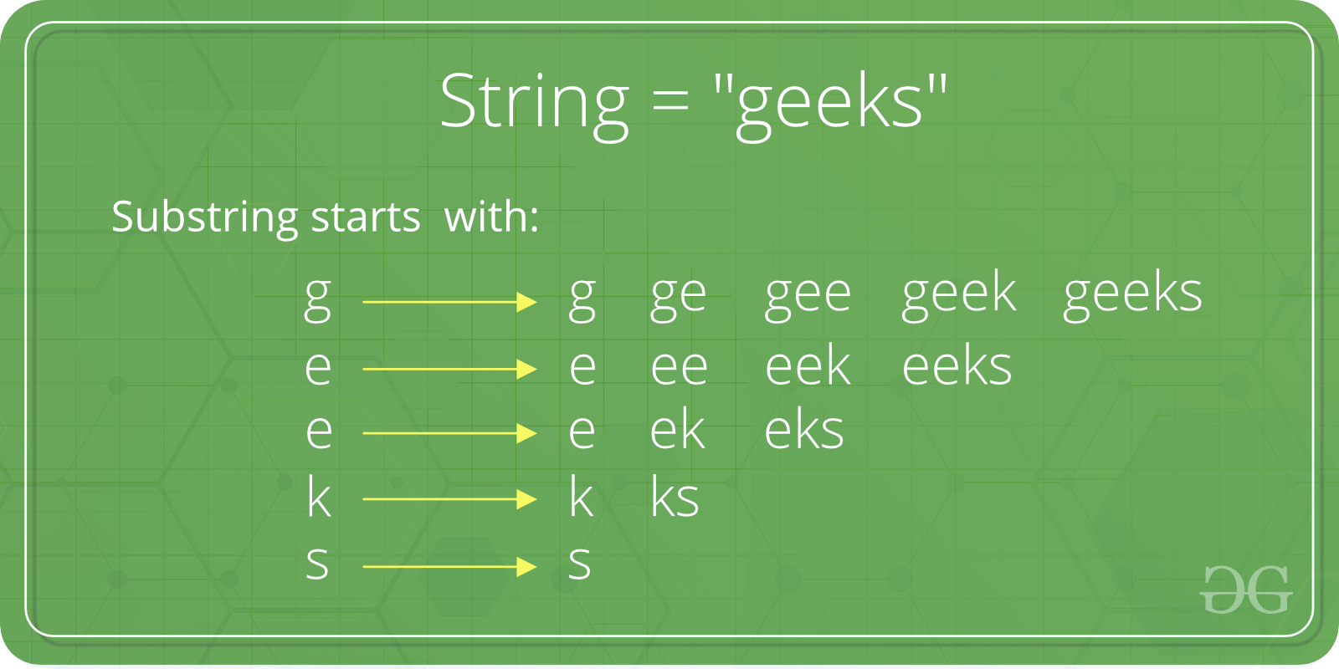
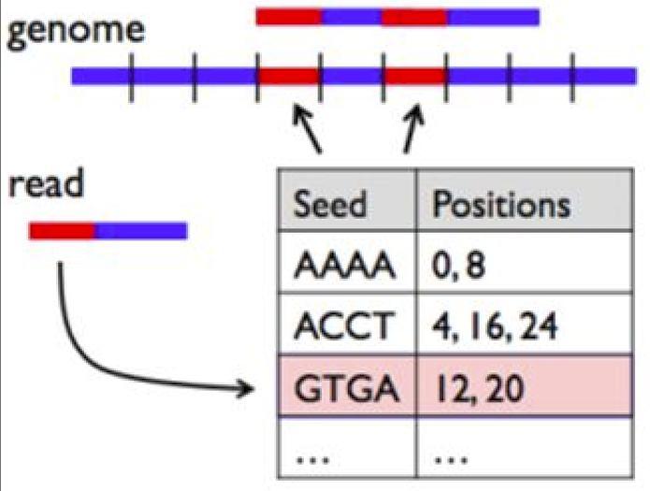
Project Proposal
Bioinformatics deals with large DNA sequences consisting of billions of base pairs.
Algorithms like BLAST, LASTZ are used to search for substrings of length k (called kmers) in these sequences.
Seed table is essentially a look-up table of possible substrings of length k, so that substrings can be found in O(1) time.
Our goal is to parallelize this seed table construction and then use it to find sequences of arbitrary length in parallel.
Notes:
Bioinformatics deals with extremely large DNA sequences consisting of billions of base pairs. For a lot of gene research, we need to find substrings in the DNA sequence that match a given pattern, which can take a long time for the reference lengths in question. Bioinformatics algorithms like BLAST and LASTZ use seed tables for this search. A seed table is essentially a lookup table that can be used to search for patterns of length k in the long reference sequence. The objective of this project is to parallelize the construction of seed table on GPU, and use this seed table to find substrings of arbitrary length, again in parallel.

Slide 3
Motivation
DNA sequences made up of a combination of four letters (A, C, G, T)
A seed table creates two arrays to look-up
An offset array of length 4^k where each element contains the last position of the corresponding kmer in the sorted position array.
A position array of length (seq_l - kmerSize + 1) of positions of sorted kmers in the original sequence.
Since the substrings are independent, lot of operations of the seed table construction and searching can be done in parallel
Notes:
DNA is made up of 4 bases: adenine, cytosine, guanine, thymine, which are represented by 4 characters in the reference sequence. A seed table used to search for kmers, which are k-length substrings in the reference string, consists of two arrays. The offset array is an array of size 4^k, where the value at each index corresponds to the last index of the corresponding kmer in the sorted position array. The position array is an array of length seq_l - kmerSize + 1, where seq_l is length of the reference string. Every index contains positions of a kmer, whose value is known from the offset table. Since substrings are independent, a lot of operatioln of the seed table construction and search can be parallelised.

Slide 4
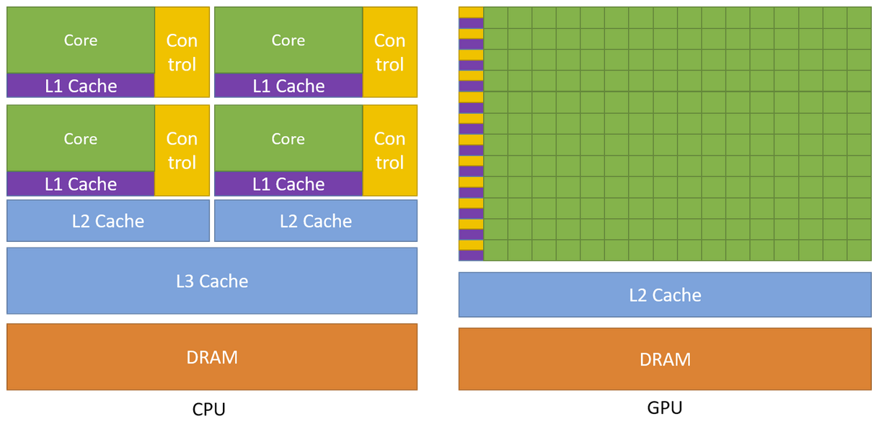
CUDA overview
CUDA is a parallel computing platform and application programming interface that allows software to use NVIDIA GPUs for general purpose processing
GPU is a powerhouse of lots of computing cores and high memory bandwidth to allow parallel processing of data
Notes:
We used CUDA for the project, which is a language developed by NVIDIA that can be used to apply GPUs for general purpose computing. GPUs have a lot of compute cores and high memory bandwidth, allowing a lot of simple computations to execute in parallel.

Slide 5
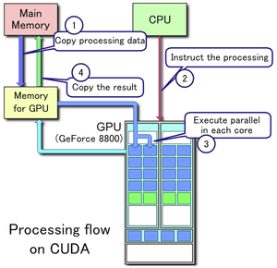
Programming flow
CPU copies data from host (CPU) memory to device (GPU) memory.
CPU calls CUDA kernels with a specified number of blocks and threads per block.
GPU executes instructions in groups of threads called warps, that execute on same instruction but different data (SIMD)
CPU copies data from device memory to host memory
Notes:
How GPUs execute programs is that we first copy all the necessary data from CPU to GPU. The CPU then calls CUDA kernels with a given number of blocks and threads. These kernels are launched in parallel and can compute the same instructions on multiple data. Once these kernels are complete, we copy the results back from GPU to CPU. If the computation on GPU is not extremely efficient, the

Slide 6
Challenges
To find a substring of length L, we can create a seed table with kmers of length L. Or we can create a seed table of smaller kmer size and run multiple iterations to find positions. We can then reference this seed table to find hits using the offset array and position array.
If substring is large, the offset array sizes increase exponentially
For example, if the reference string has length 64,
With kmer size of 2, we need 16 entry offset table and 63 entry position table. The calculation of a bigger string (say of length 10) requires to loop over 5 times to find a match.
With kmer size of 4, we need 256 entry offset table and 60 entry position table. The calculation of a bigger string (say of length 10) requires to loop over 3 times to find a match.
With kmer size of 8, we need 65536 entry offset table and 57 entry position table. The calculation of a bigger string (say of length 10) requires to loop over 2 times to find a match.

Slide 7
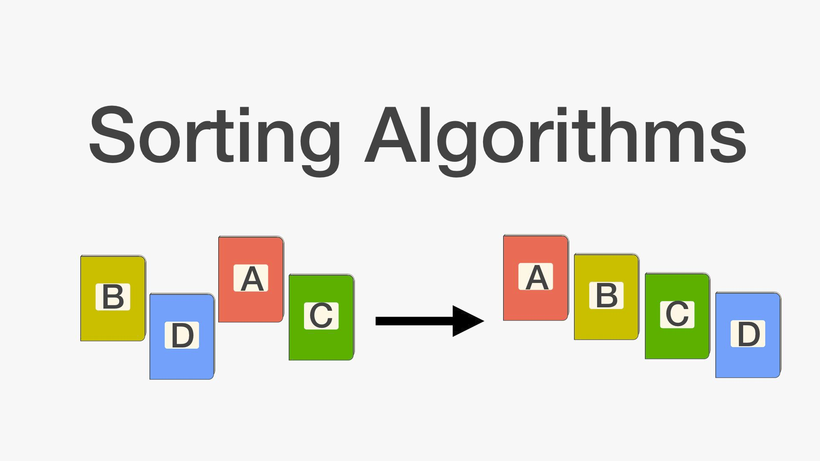
Challenges
Offset table is a table of all possible kmers and their last position in the sorted position array.
Entry 1 corresponds to AAAA
Entry 2 corresponds to AAAC
Entry 10 corresponds to AAGC
Entry 256 corresponds to TTTT
The bottleneck is offset table size which increases exponentially with kmer size, and sparse (many kmers may not be present in the reference sequence)
Sorting is a difficult task to parallelize as general sorting techniques have relied on comparing element to the next element and swapping
There are algorithms that allow to parallelize on GPUs efficiently like Radix Sort, Quick Sort, Merge Sort

Slide 8

Step 0: CPU Compression
Letters are stored as characters (1 byte per character) on CPU in the original reference string.
Transferring 1 Million characters requires ~ 1MB transfer
Since the string consists of only 4 letters (A, C, G, T), we can encode the string using 2 bits.
We can now group 16 such letters to form a 4-byte 32-bit unsigned integer and transfer to GPU.
By compression, we save 75% of memory utilization and cudaMemcpy overhead (1M letters now take 250KB).
ACGT=> 00 | 01 | 10 | 11 (Instead of 01000001 | 1100100 | 01000111 | 01110100)

Slide 9
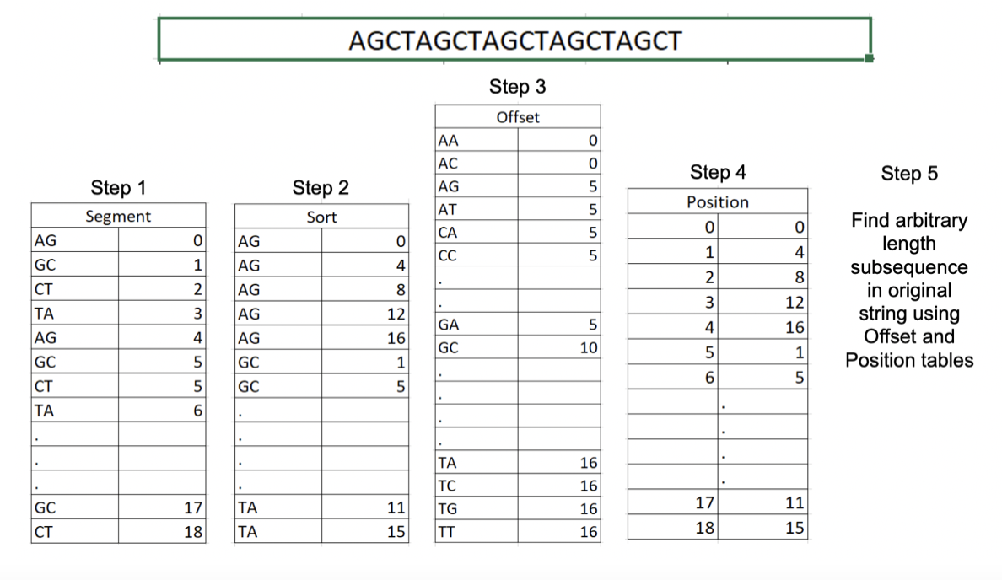
GPU Algorithm Overview

Slide 10
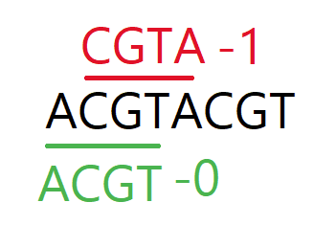
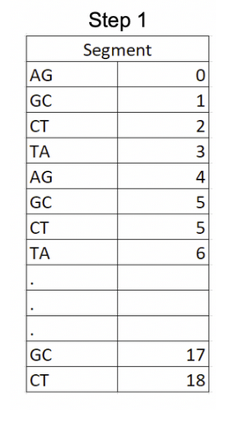
Step 1: GPU Segmentation
For our project, we use a kmer size of 4 to create a seed table, so any arbitrary length of 4 and more sequences can be searched.
We spawn multiple threads to segment the compressed reference string (of 16 letters per integer) into 4 letter kmers.
We store each kmer in an array kmerPos as a 64 bit unsigned integer (size_t). The first 32 MSBs represent the kmer, and the last 32 LSBs represent the kmer position in the reference.

Slide 11
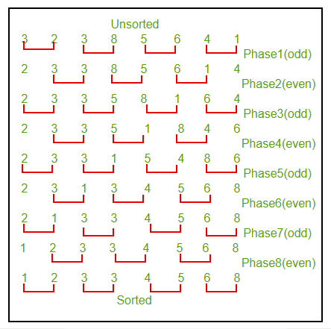
Step 2: GPU Sorting
While there are multiple sorting algorithms, a lot of them are not efficiently parallelizable on GPU.
CUDA offers a library called thrust that has several efficient GPU sorting algorithms.
Radix sort is the most popular and fastest GPU sorting algorithm.
In the interest of time and simplicity, we implemented a parallel odd-even sort on GPU.

Slide 12
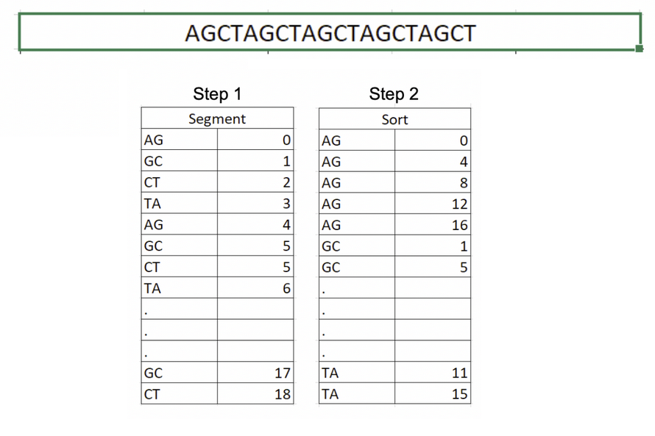
Step 2: GPU Sorting

Slide 13
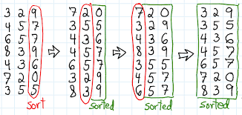
Aside: Radix Sort

Slide 14
Step 3: GPU Offset Table
Now that we have a sorted table of kmers and their positions, we need to populate the offset table, where the value at each index is the final index of the corresponding kmer in kmerPos.
Offset table can be calculated by spawning multiple threads, and each thread compares adjacent kmers, kmer1 and kmer2 (32 MSBs) in kmerPos. If they are different, indices kmer1 through kmer2 of the offset table are populated with the index of kmer2 in kmerPos.
We now have an offset table where each value corresponds to the final index (in kmerPos) of the kmer represented by the index, and starting index is represented by the value at the previous index of offset table.
For example, if value at index 3 (AAAT) of offset table is 10 and value at index 2 (AAAG) is 4, indices 4 - 9 in the kmerPos contain hit positions of AAAT in the reference string.

Slide 15
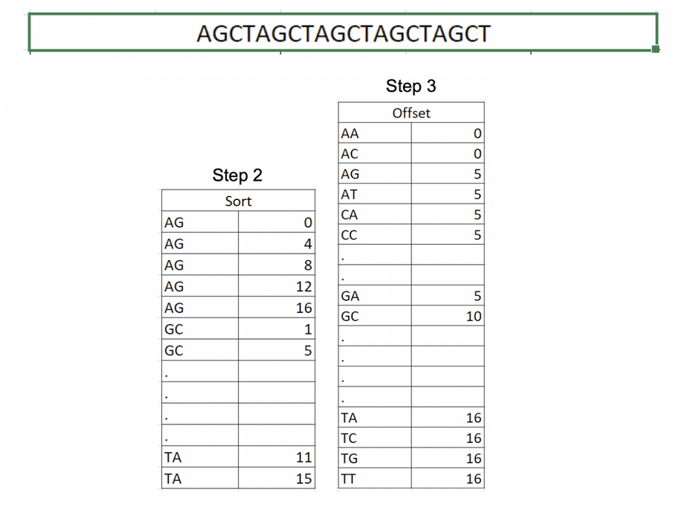
Step 3: GPU Offset Table
kmerPos
Offset Table

Slide 16
Step 4: GPU Position Table
kmerPos already contains the sorted kmers in the reference string and their corresponding positions. We need to get rid of the kmer position in the 32 MSBs, which was initially added to achieve sorting successfully.
We simply mask the 32 MSBs of kmerPos, to find only the positions of the kmers. The offset table gives information about which indices in kmerPos give the positions of which kmer.
For example, if we want to look for AAAT, we look up index 3 (which is 10 from the last slide) and index 2 (= 4) on the offset table. Now we take values at indices 4 - 9 in the kmerPos, which gives the positions of AAAT
This step was achieved with a simple parallel map on GPU.

Slide 17
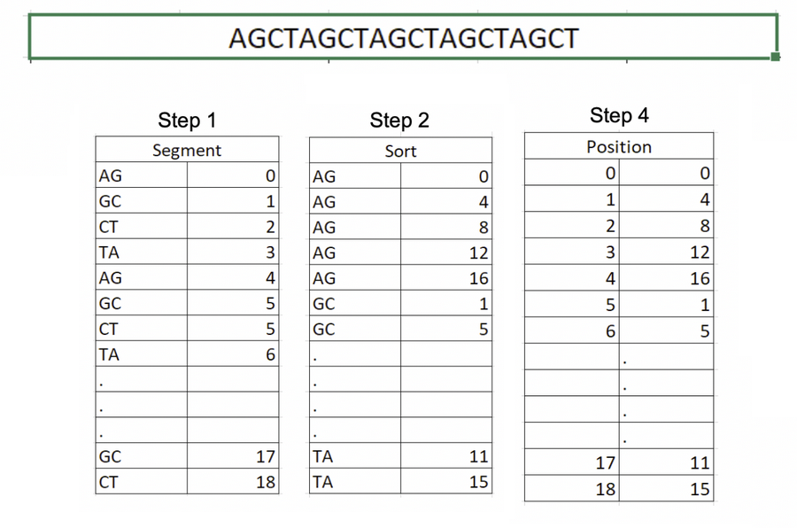
Step 4: GPU Position Table

Slide 18
Step 5: GPU Searching
We have a seed table which can be used to find positions of length 4 kmers in the reference string using offset table and kmerPos.
This function is used to find positions of arbitrary length sequences (length L >= 4) in the reference using the seed table of 4-mers.
We achieve this with 3 CUDA kernels, and 64-bit unsigned int array posArray of length seq_l-kmerSize+1 (maximum hits possible)
posArray is then copied to CPU and hit positions are printed.

Slide 19
Step 5: GPU Searching
Algorithm:
Kernel 1: Find positions of first 4-mer in the substring, left-shift by 32, and save it to posArray. Find start and end positions from offset table; each thread writes one position to posArray.
Repeat Kernel 2 (L / 4) times
Kernel 2:
Take next 4-mer in the substring, find its positions with individual threads.
If L % 4 != 0, the last 4-mer is the last 4 characters of the substring.
Each block corresponds to one element of posArray right shifted by 32, pos.
Calculate an offset value off (if substring length not a multiple of 4).
If position of current 4-mer = pos + 4 - off, increment the original value in posArray[blockId] by 1.
Kernel 3: Each thread checks individual elements of posArray. If the 32 LSBs correspond to the number of iterations of Kernel 2, then there was a complete match, and that position (32 MSBs) is saved, else it is made 0.

Slide 20
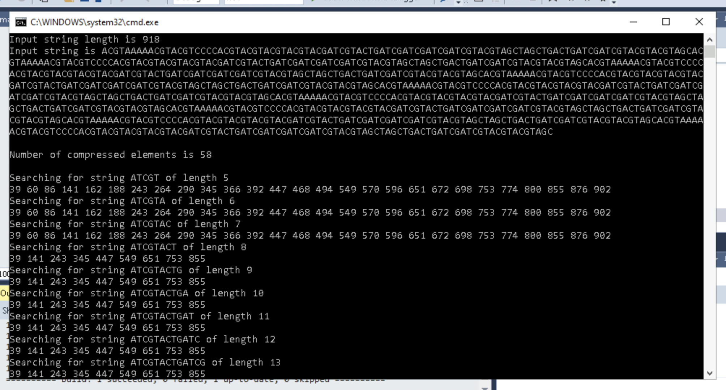
Code Snippets and Sample Outputs

Slide 21
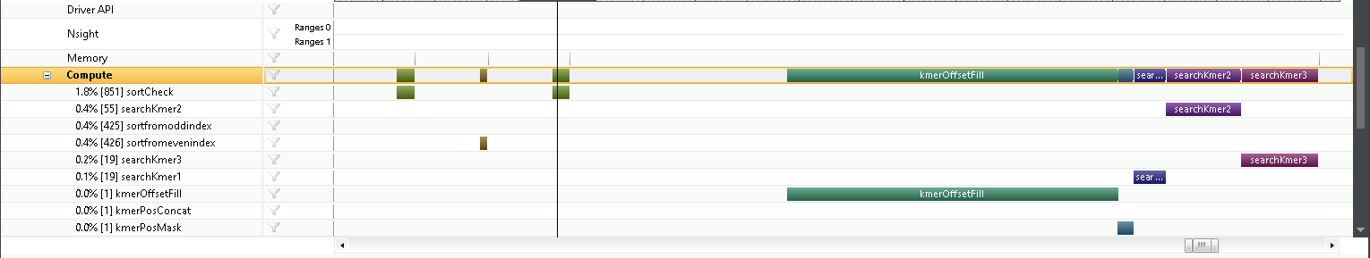
Profiler

Slide 22
Future Work and Improvements
Currently, we create a seed table of kmer size 4. We can modify the code to take variable kmer lengths, which can be adjusted to trade-off between memory footprint and computation complexity (current code is mostly scalable by defining kmerSize, and most functions are generalized for variable kmerSize)
Each of the CUDA kernel calls of Kernel 2 works on independent kmers. So they can also be called in parallel instead of sequentially from CPU (we can declare a 2D block where threadIdx.x corresponds to one position of posArray and threadIdx.y corresponds to positions of the current 4-mer in question, and each block can compute different 4-mers; need more time to think about exact implementation)

Slide 23
Thank You

